Slide 1


Python Fundamentals
Innovation Masters
Day 17

Slide 2
Today’s Agenda
Make an application for personal finances
We will keep track of weekly financial information of a user
Save those information in files for reading later and editing

Slide 3
Class specifications
Account variables:
Cash
Debtors
Liability
Weekly Budget

Slide 4
Methods for Account
add_expense(self, amount)
add_income(self, amount)
add_debtor(self, amount)
add_liability(self, amount)
show_summary(self)

Slide 5
Menu Options
Add income -> add cash
Add expense -> subtract cash
Give loan -> subtract cash, add debtors
Take loan → add cash, add liabilities
Edit weekly budget -> change value
View account summary
Quit

Slide 6
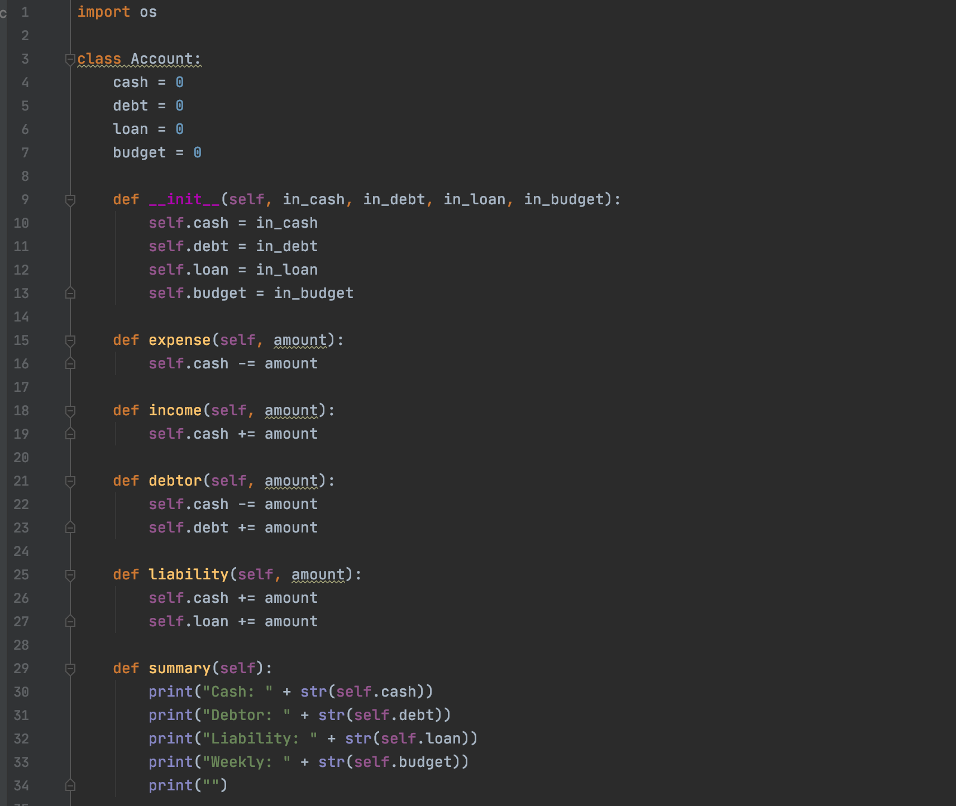
Solution

Slide 7
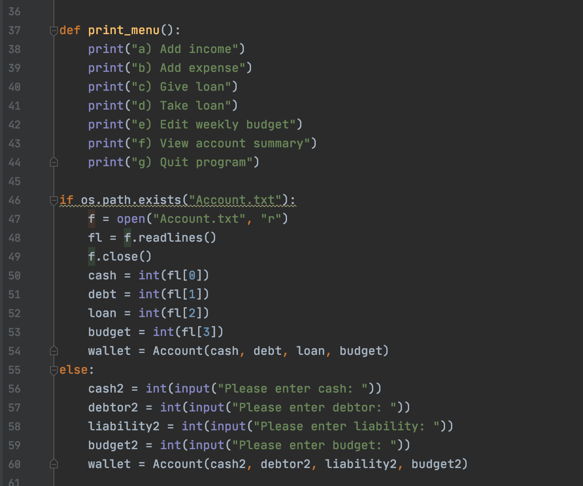
Continued

Slide 8
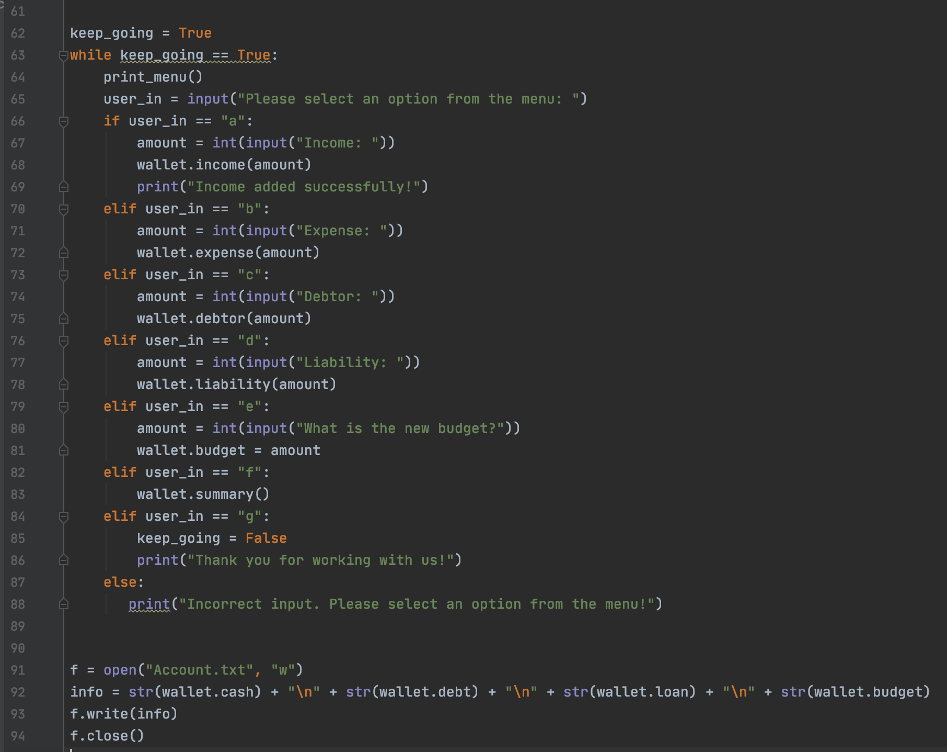
End of solution

